Slide 1
SPELLING WORDS WEEK SIX

Slide 2
I came to school at 8 o’clock.
came

Slide 3
She is a happy girl.
happy

Slide 4
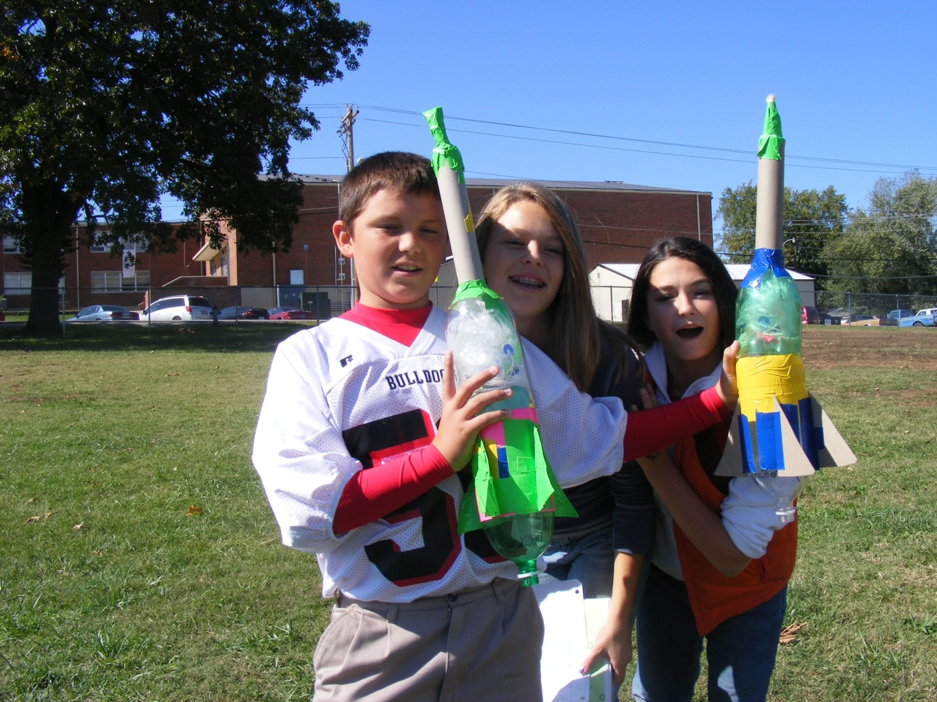
made
We have made rockets.

Slide 5
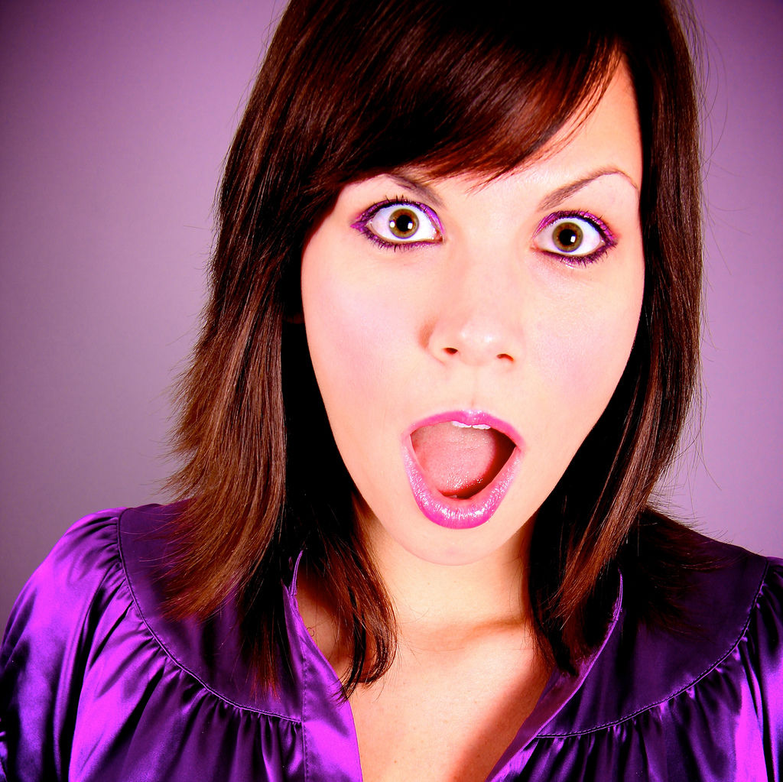
I saw a monster.
saw

Slide 6
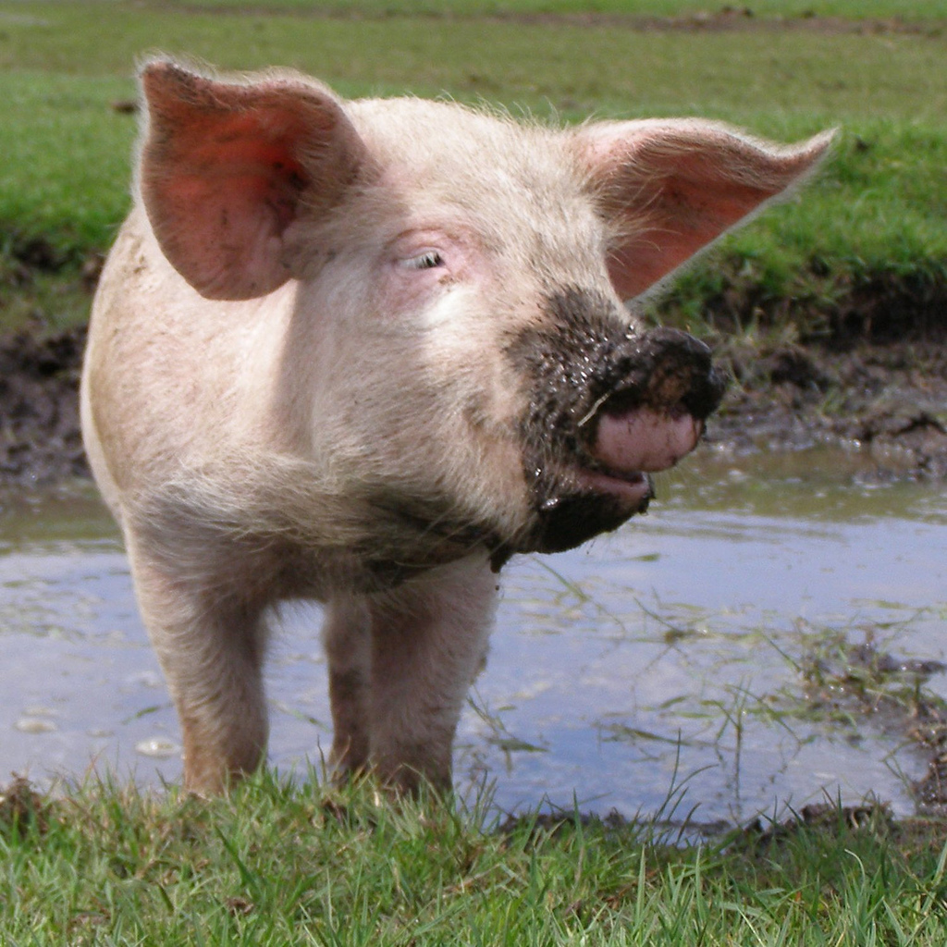
pig
The pig is dirty.

Slide 7
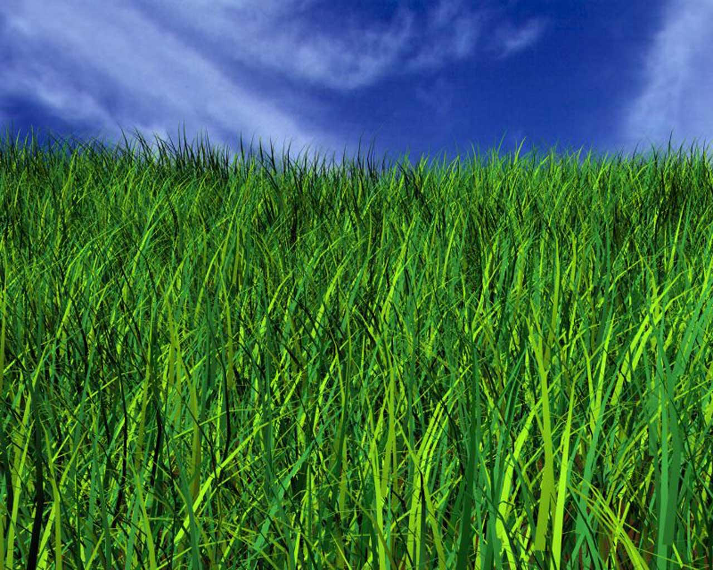
The grass is green.
grass

Slide 8
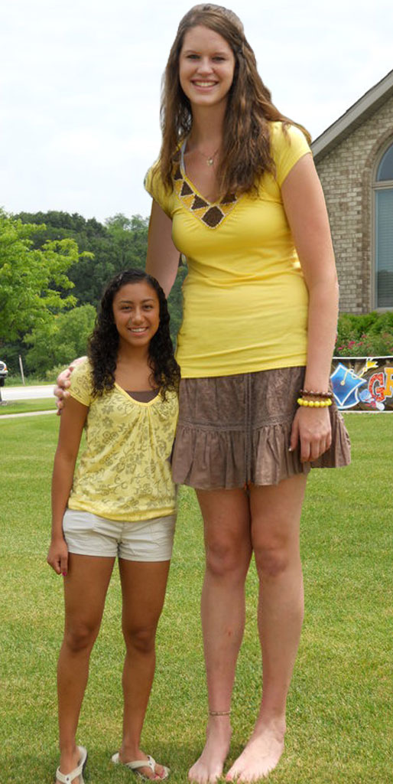
tall
She is so tall.

Slide 9
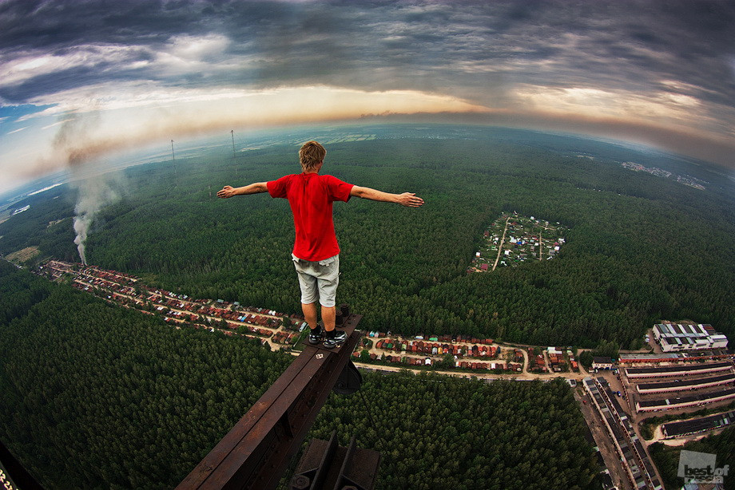
fall
He is going to fall.

Slide 10
one
I want to be number one.

Slide 11
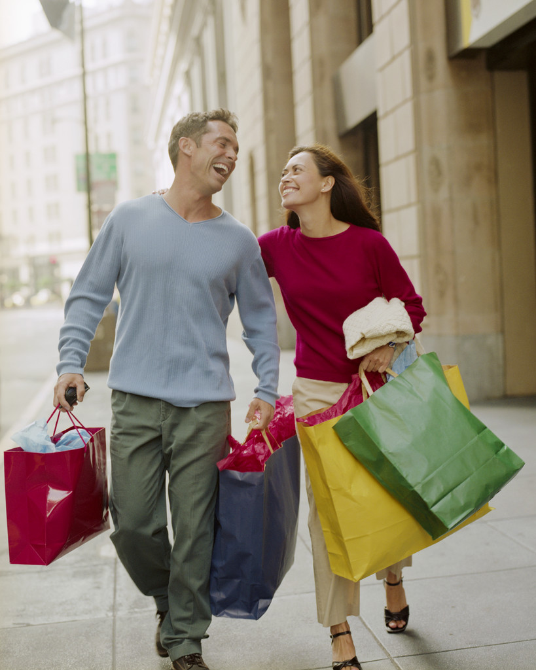
Two happy people.
two

Slide 12
OUR TEN SPELLING WORDS
came 6. grass
happy 7. tall
made 8. fall
saw 9. one
pig 10. two

