Slide 1
The ar Sound
The Words For Week Thirteen

Slide 2
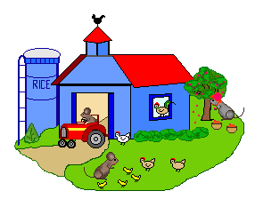
152
car
154
star
farm
153

Slide 3
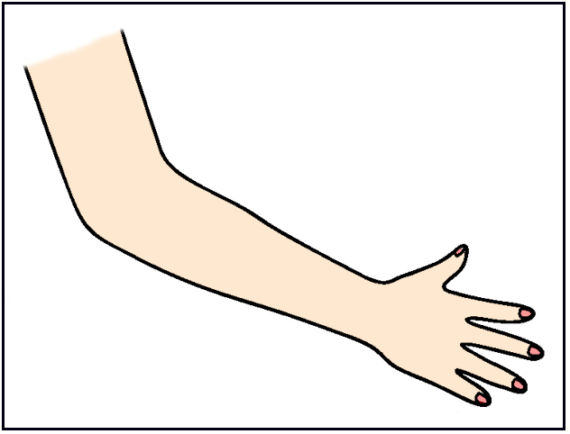
156
start
arm
155
card
157

Slide 4
art
158
dart
159

Slide 5
161
cart
160
jar

Slide 6
There Are 10 Words To Learn In Week Thirteen.
Not Many This Week. Good Luck.

