Slide 1
The q and wh Sounds.
The Words For Week Fourteen.

Slide 2
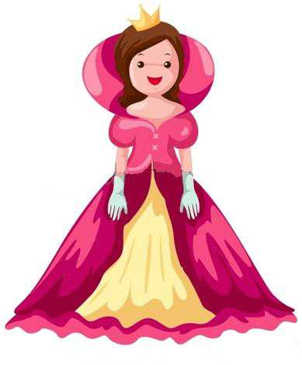
162
white
164
queen
163
quack

Slide 3
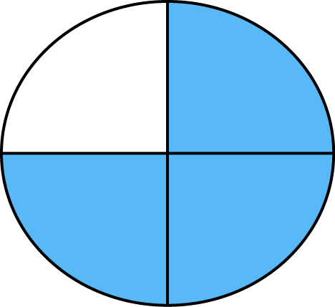
166
whistle
wheel
quarter
165
167

Slide 4
170
168
whale
quick
169
quiet

Slide 5
There Are 9 Words To Learn In Week Fourteen.
Not Many This Week. Good Luck.

