Slide 1
The Long A Sound
The Words For Week Twenty

Slide 2
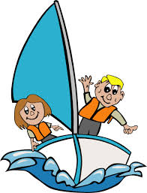
229
231
hay
day
230
sail

Slide 3
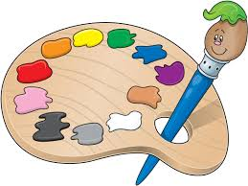
nail
233
paint
232
rain
234

Slide 4
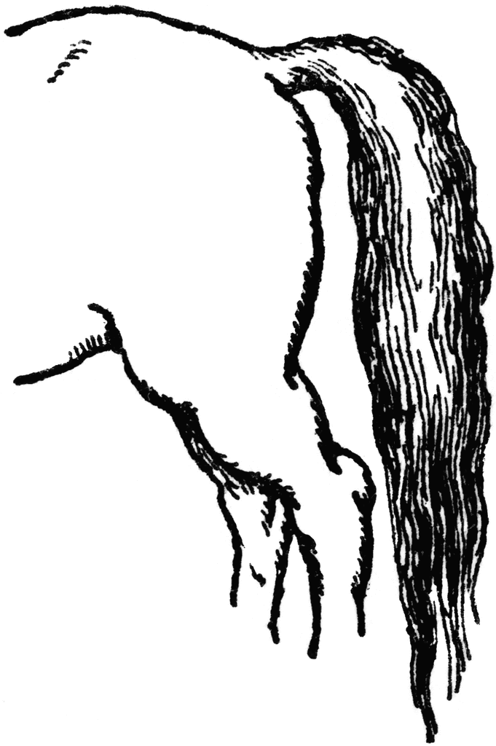
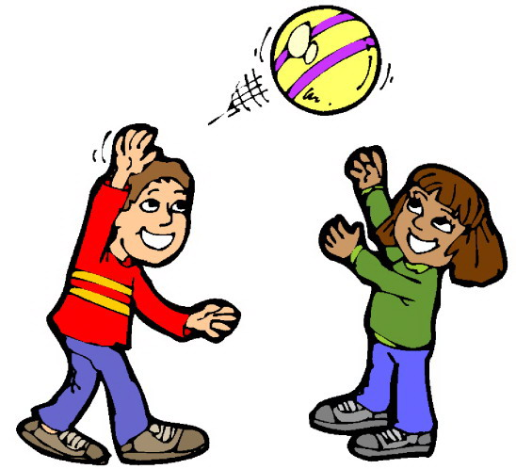
235
237
play
gray
236
tail

Slide 5
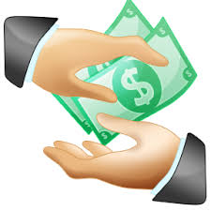
say
239
238
pay

Slide 6
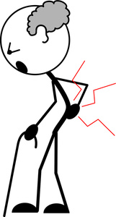
240
pain
tray
241

Slide 7
There Are 13 Words To Learn In Week Twenty.
You Can Be A Star.
Good Luck.

